Slide 1
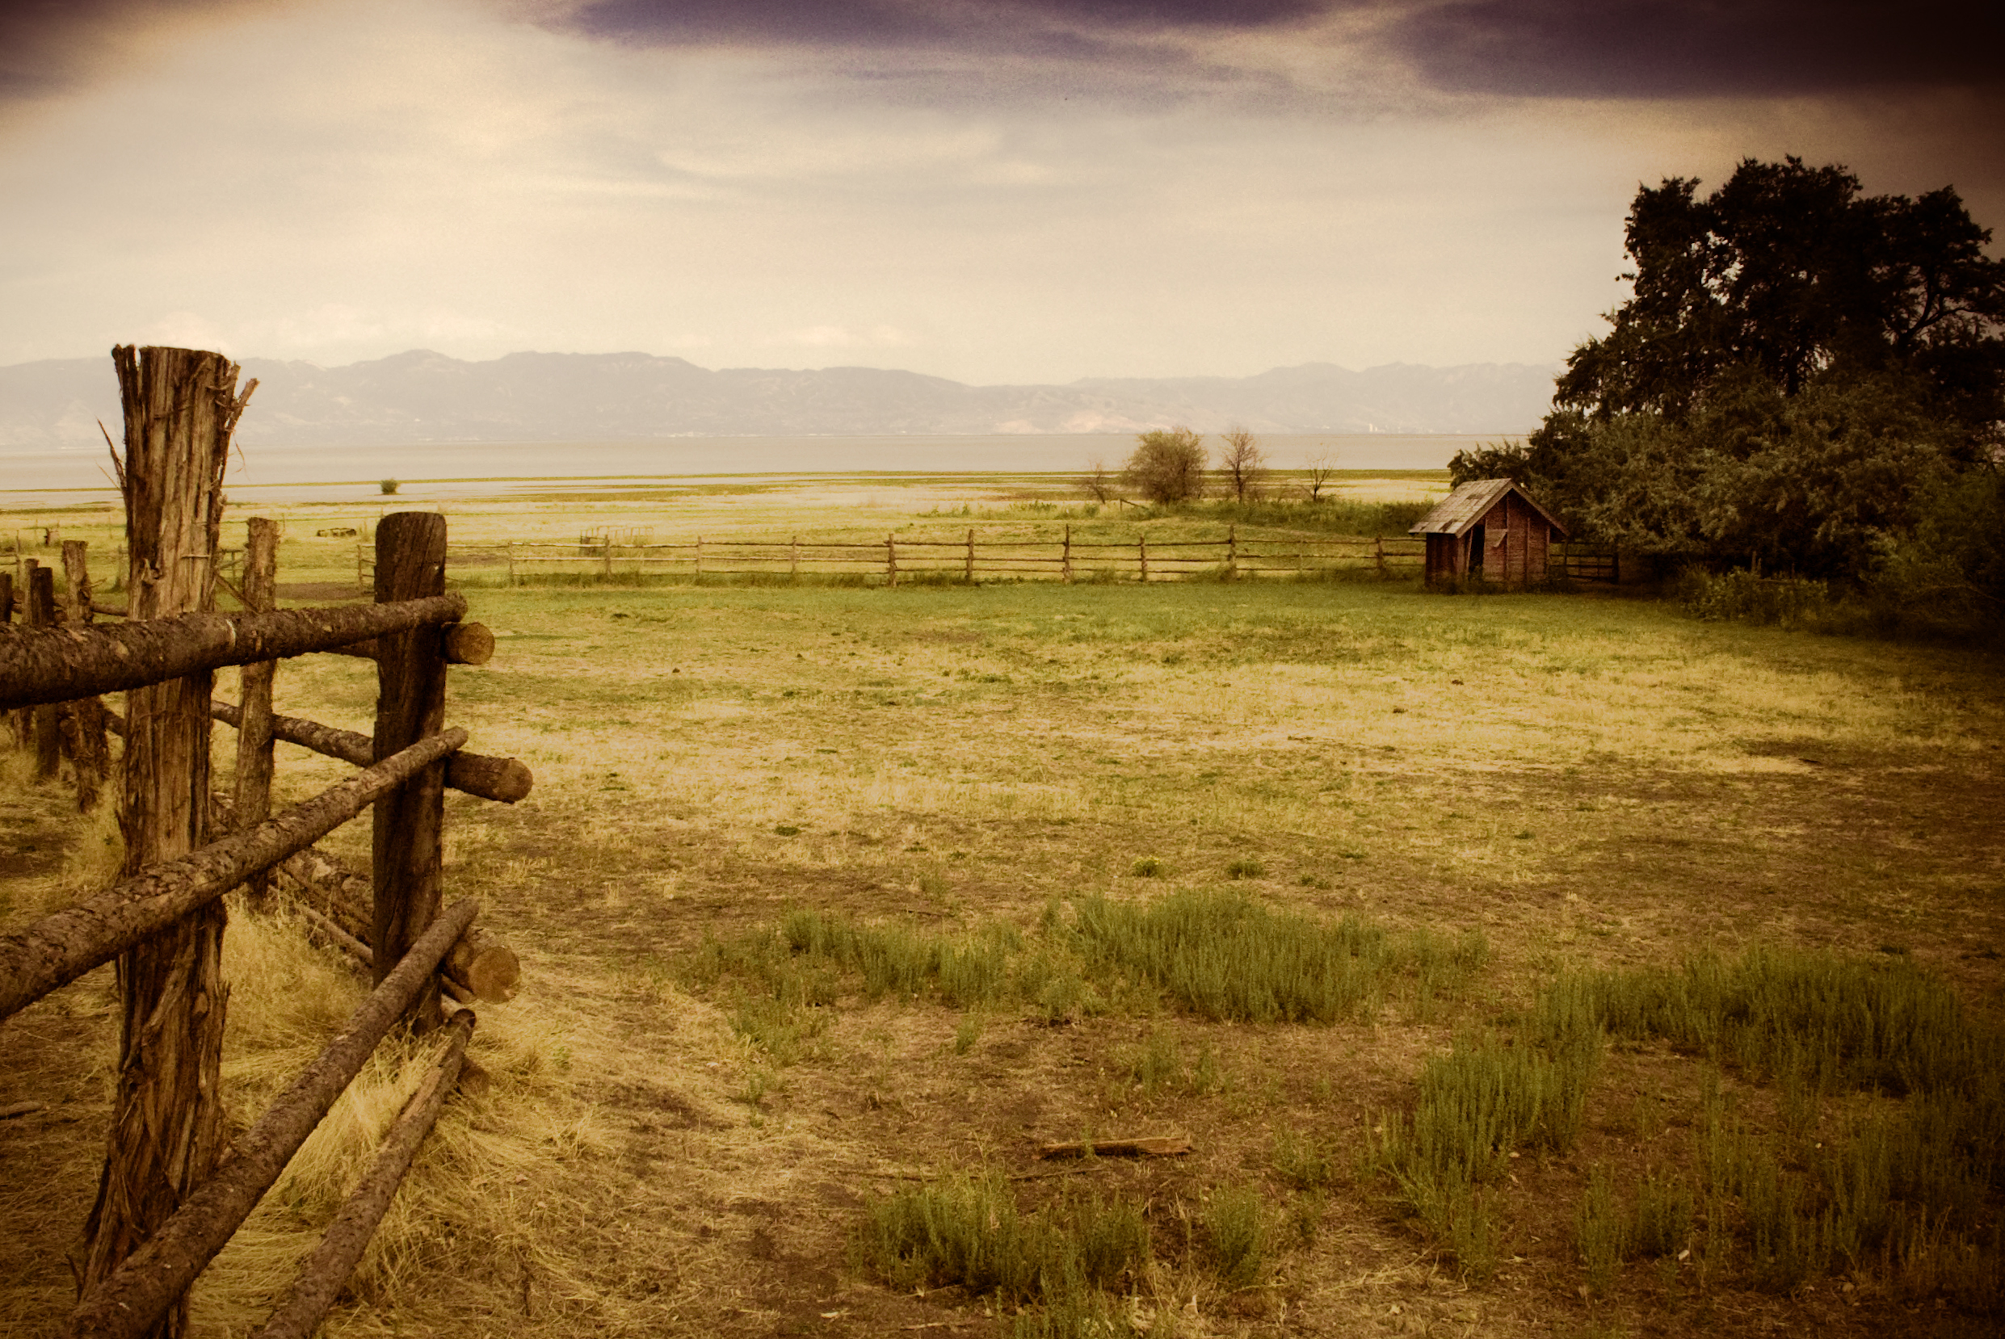
An Ecological Approach to Of Mice and Men

Slide 2
John Steinbeck
1902-1968
Born in Salinas, California
“I think I would like to write the story of this whole valley, of all the little towns and all the farms and the ranches in the wilder hills. I can see how I would like to do it so that it would be the valley of the world.” Steinbeck’s letter to George Albee, Salinas, 1933
Steinbeck used his PLACE to impact his writing
Microcosm - “small world” – the world as a whole encapsulated in a tiny version
Steinbeck attempted to make his stories relatable to readers by writing characters who are like us or like people we know

Slide 3
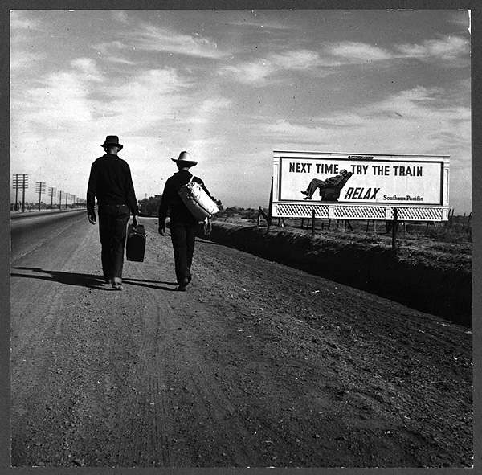
Of Mice and Men
Great Depression
Migrant workers
PLACE – having and not having a PLACE
Powerful and Powerless – American Dream?
Security – Loneliness - Solitude

Slide 4
Ecology Ecosystem Predation
The branch of biology that deals with the relations of organisms to one another and to their physical surroundings
A biological community of interacting organisms and their physical environment. (in general use) a complex network or interconnected system.
A relation between animals in which one organism captures and feeds on others

Slide 5
What are some examples of ecosystems?

Slide 6
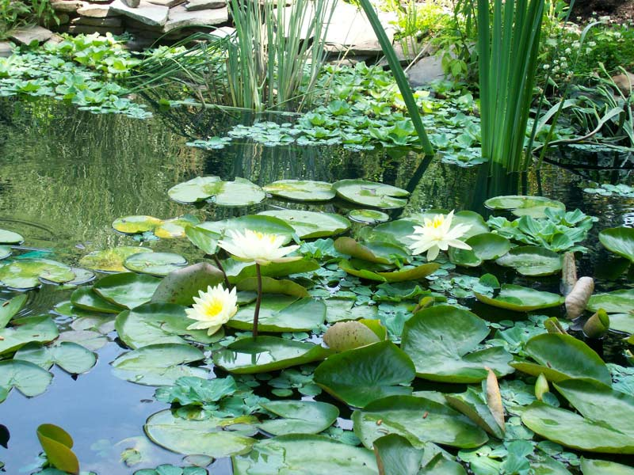
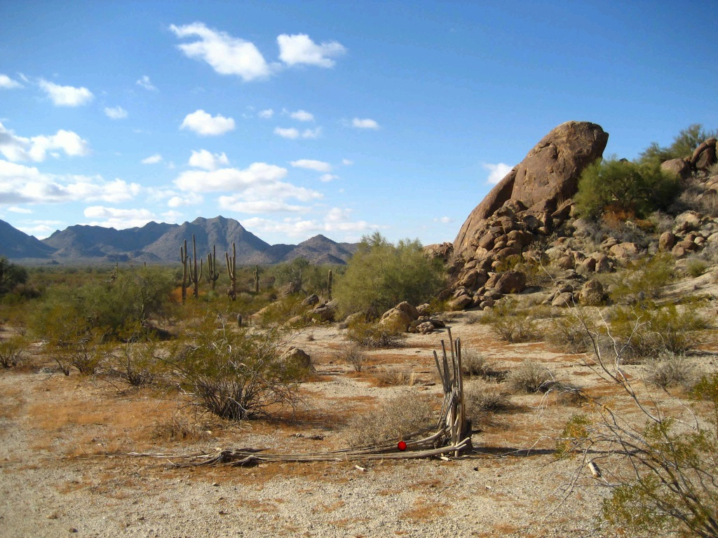
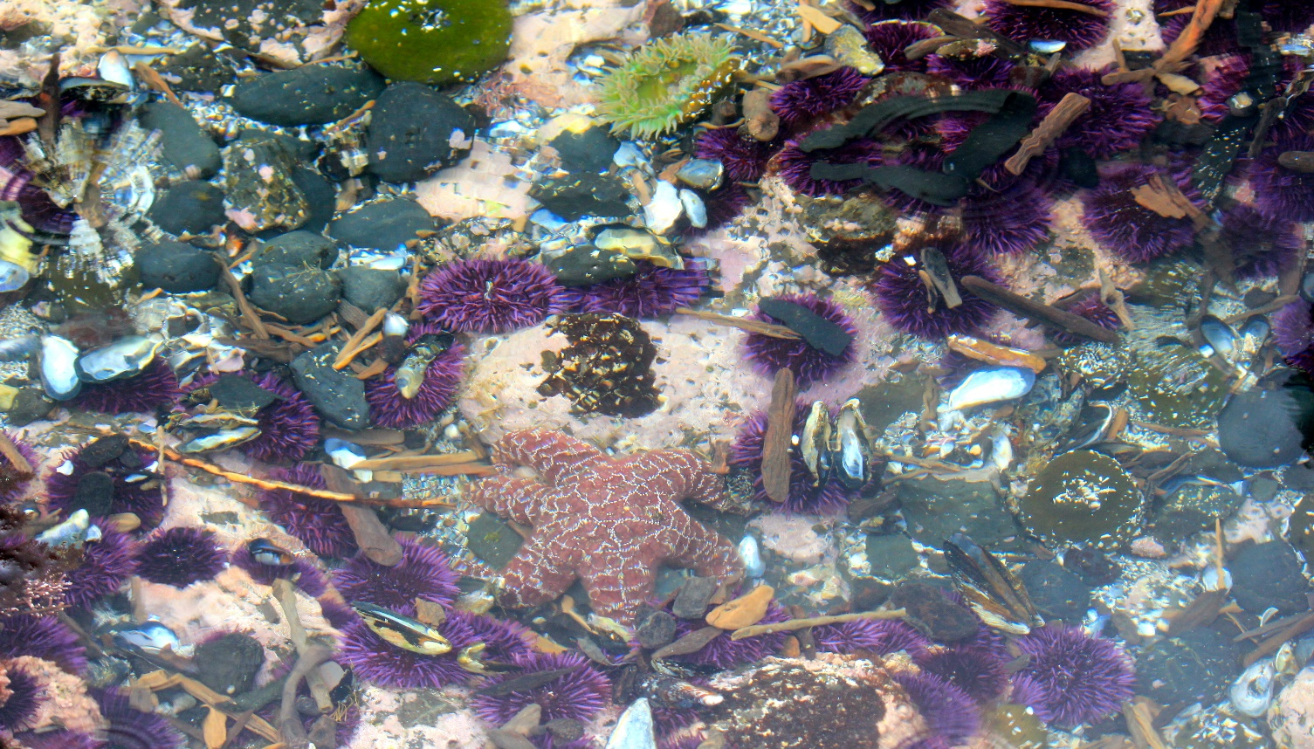

Slide 7
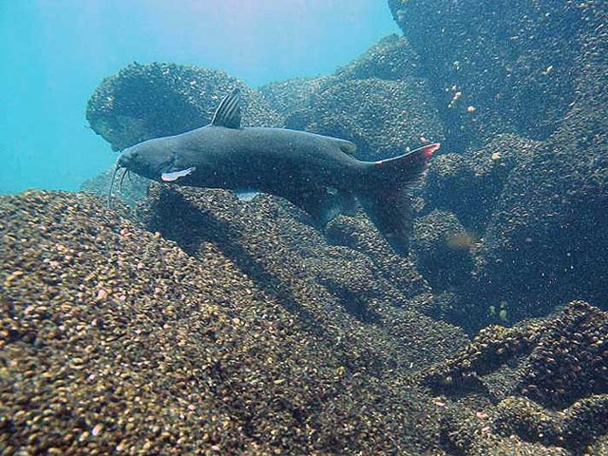
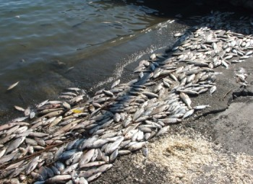
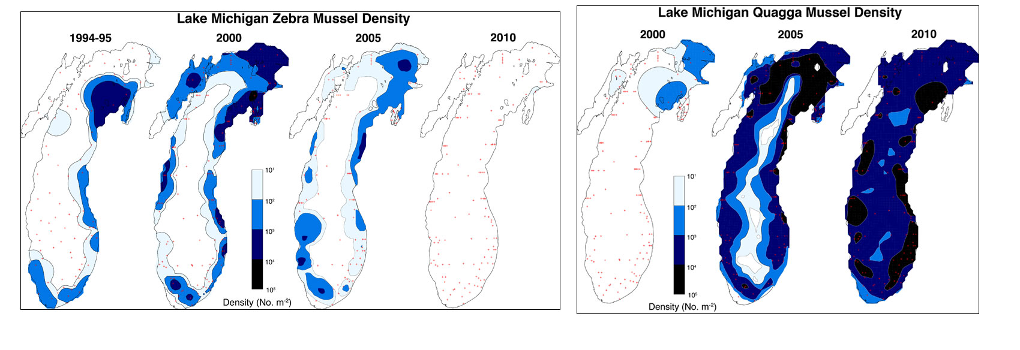
Healthy vs. Unhealthy Ecosystems
Healthy – productive, resilient, diverse
Unhealthy – unproductive, overpopulated, unbalanced
Invasive Species - Asian Carp and Zebra/Quagga Mussels in the Great Lakes

Slide 8
As you read Of Mice and Men, think of “the ranch” as an ecosystem
How does the ranch exist BEFORE we become aware of it?
What happens when George and Lennie arrive?
Are George and Lennie an invasive species?
Do the other people on the ranch respond to them appropriately?
Is “the ranch” a healthy or unhealthy ecosystem?
What would happen if we were to remove one of the major characters?
How does predation work on “the ranch”?
Are there predators and prey?
Who is powerful and who is powerless? Why?
How does survival of the fittest play a role on the ranch?

